Slide 1


ELECT
KENDA TOMES
McCLAIN
Campaign Strategy, Service Delivery Timeline & Proposal
for Mayor of Kansas City, Missouri
Prepared by JPP Consulting
AI-Based Political Consulting & Social Sentiment-Driven Campaign Deliverables
kendatomesmcclain4kc.com

Slide 2
Thank You, Kenda — Scope & Campaign Window
Primary proposal only: April 2027 nonpartisan mayoral primary
Thank you for the opportunity
Scope Note
• This proposal is built to carry a disciplined message Kansas City can trust.
• The campaign will position Kenda as a fiscally serious leader focused on families, accountability, and results.
• Every recommendation is designed to reach voters where they live, scroll, stream, and gather.
• Primary campaign deliverables only.
• Kansas City’s nonpartisan municipal primary is expected in April 2027.
• Working planning date: April 6, 2027, pending the official Election Board calendar.
• A June 2027 runoff/general election proposal will be prepared separately if Kenda advances.
kendatomesmcclain4kc.com | Primary Campaign Deliverables Only |Prepared by JPP Consulting

Slide 3




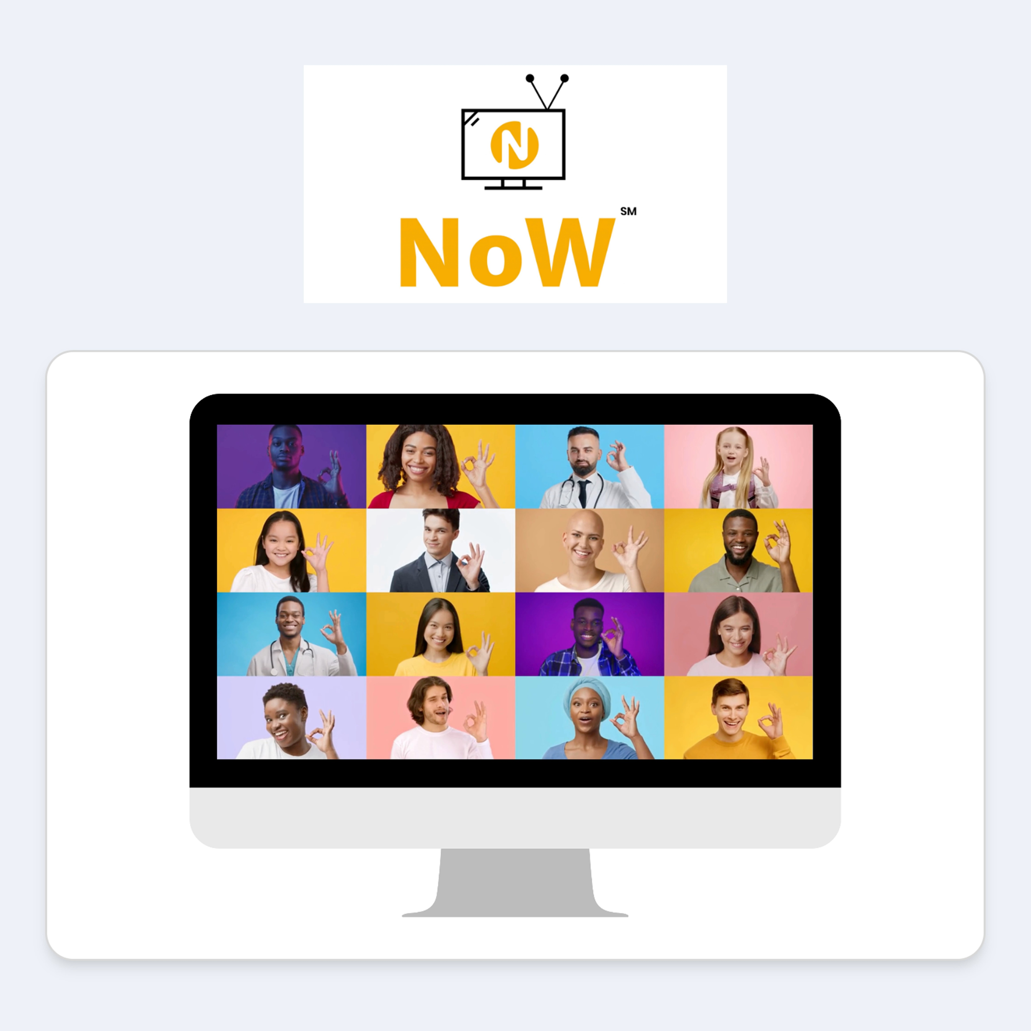



Meet the JPP Consulting Team
Enterprise-grade marketing technology, human oversight, and disciplined messaging
100+ Years’ Combined Experience
Digital Marketing • Software Development • Telecommunications • Best-in-Breed IT Products • Human Resource Management
AI Accountability Audit
AI Agent
Intent Digital Marketing
AI Data Center Consulting / Backlash-to-Partnership Advisory
Enterprise-grade AI ethics and governance assessment
AI-powered contact
handling with human oversight
Multichannel campaigns, copywriting for measurable results
NoW Video
Ask Carrie
Explainer Videos
Strategic AI Development
Real-Time Voice Translation / Transcription video chat
AI-knowledge Base
Animated educational videos
End-to-end design / build / host / manage

Slide 4
Website Revamp → Immediate Brand Build
As soon as kendatomesmcclain4kc.com is revamped, the brand-building engine starts
1. Launch the refreshed brand
2. Install tracking & learn fast
3. Build recognition daily
4. Virtual Assistance + Phone
Updated design, pillar messaging, and conversion paths.
Campaign colors, headline hierarchy, calls-to-action, donation/volunteer flows.
Consistent visual language across web, social, text, and streaming.
Website tracking code activated immediately.
Visitor behavior informs issue messaging and retargeting.
Dashboards monitor clicks, returns, video views, donations, and volunteer intent.
Daily posting begins with Kenda’s refreshed message and look.
Brand recall grows by zip code, generation, and issue interest.
Every channel reinforces the same Public Safety, Infrastructure, and Economic Opportunity story.
Set up virtual assistance with a dedicated phone number to handle incoming calls, texts, and scheduling.
Capture voter questions, meeting requests, volunteer interest, event RSVPs, and donor follow-up needs.
Route conversations to the campaign team/CRM so no important contact is missed.
kendatomesmcclain4kc.com
Primary Campaign Deliverables Only Prepared by JPP Consulting

Slide 5
This Is How You Win
Message discipline + voter data + authentic service
The winning formula is simple:
message discipline + voter data + authentic service
Primary Objective
• Position Kenda Tomes McClain as a trusted problem-solver and fiscally serious leader — not politics as usual.
• Market the candidate with precision, backed by AI, human oversight, and a genuine record of community service.
• Deliver the right message, to the right generation, in the right zip code — repeated consistently until the primary.
• Use social, streaming TV, TargetText, web tracking, virtual town halls, and multilingual access to reach every Kansas City community.
Advance Kenda through the April 2027 top-two mayoral primary by making fiscal discipline, safer neighborhoods, reliable infrastructure, and shared opportunity the campaign’s unmistakable brand.
kendatomesmcclain4kc.com | Primary Campaign Deliverables Only |Prepared by JPP Consulting

Slide 6
The Candidate’s Story
30+ years in finance and civic leadership
Kansas City needs leadership that reflects the values of voters — leadership that values family over special interests, hates waste, and does more than give speeches.
Public Safety
Infrastructure
Economic Opportunity
Safer neighborhoods, faster response, community trust, and support for families affected by violence.
Reliable basic services, roads, water, transit, and neighborhood-level accountability.
Finance expertise applied to jobs, small business, cost of living, and accountable development.
kendatomesmcclain4kc.com
Primary Campaign Deliverables Only Prepared by JPP Consulting

Slide 7
Sentiment Analysis: What Greater Kansas City Thinks
Measure Kenda’s three pillars by zip code, generation, and issue intensity
Pillar | What We Measure | How It Shapes the Message
Public Safety | Crime, response times, domestic violence, and neighborhood trust. | Frame Kenda as the disciplined, results-first leader voters can trust to make neighborhoods safer.
Infrastructure | Roads, transit, water, and basic-service reliability across KC neighborhoods. | Lead with Kenda’s fix-what’s-broken competence and neighborhood accountability.
Economic Opportunity | Jobs, small business, cost of living, and development that benefits residents. | Position Kenda’s finance expertise as the credible path to shared, accountable growth.
Deliverable: Greater Kansas City sentiment baseline refreshed continuously through the April 2027 primary.
kendatomesmcclain4kc.com | Primary Campaign Deliverables Only |Prepared by JPP Consulting

Slide 8
TargetText Strategy: Up to 250,000 Text Messages
Strategically sent based on sentiment data, voter segment, and best time to send
What is included
How sends are optimized
Human oversight
• Up to 250,000 text messages during the primary campaign window.
• Segmented SMS/MMS outreach by zip code, generation, issue interest, and engagement behavior.
• Message variants aligned to Public Safety, Infrastructure, and Economic Opportunity sentiment.
• Best send windows determined by response patterns, sentiment signals, and voter behavior.
• A/B testing identifies strongest hooks, calls-to-action, and follow-up sequences.
• Texts support donations, volunteers, event turnout, video views, persuasion, and GOTV.
• Strategic review before major sends.
• Respectful, compliant outreach with clear sender identity and opt-out handling.
• Performance feedback loops refine daily social, streaming, and website retargeting.
Right message. Right voter. Right moment.

Slide 9
Streaming TV / Connected TV Advertising
Premium inventory, voter-file targeting, and closed-loop attribution
Available streaming environments include:
Hulu
Peacock
Paramount+
ESPN
Sling
500+
Precision Targeting
Closed-Loop Attribution
AI-Generated Video
• Age, income, homeownership, language, party, and interest.
• Matched to voter-file segments and website engagement.
• Track which voters saw ads and then visited the campaign website.
• Use results to refine social, text, and web messaging.
• Rapid production and iteration.
• Creative updated as sentiment shifts and campaign moments emerge.
kendatomesmcclain4kc.com | Primary Campaign Deliverables Only |Prepared by JPP Consulting

Slide 10
Winning Strategy & Services
The full primary campaign delivery engine
1. Data & AI Sentiment
2. Website Tracking
3. TargetText + Voicemail
Zip-code-level analysis, pillar sentiment, opponent-field monitoring, message refinement.
Revamped site, tracking code, engagement measurement, retargeting audiences.
Up to 250,000 strategic texts, MMS, segmented follow-ups, ringless voicemail drops.
4. Streaming TV / CTV
5. Daily Social Posting
6. Community Access
Premium streaming placements, voter-file targeting, website attribution.
Facebook, Instagram, TikTok, LinkedIn content aligned to the brand and daily insights.
Virtual town halls, multilingual reach, and ongoing voter engagement across KC communities.

Slide 11
Service Delivery Timeline
Week of September 14, 2026 through the April 2027 primary
Week of Sept. 14, 2026
Launch & Foundation
1
Revamp website; capture Kenda’s voice; install tracking; deliver Greater KC sentiment baseline.
Oct.–Dec. 2026
2
Message Build
Zip-code and generational message sets; brand-building content; continuous sentiment refinement.
Ongoing
Content Engine
3
Daily social posting; up to 250,000 strategic TargetText messages; ringless voicemail; AI video iteration.
Jan.–Mar. 2027
4
Streaming Air War
Launch CTV/streaming ads across premium channels; optimize with closed-loop attribution.
Through April 2027 Primary
GOTV & Rapid Response
5
Dashboards, rapid response, best-time-to-send text pushes, turnout reminders, message optimization.
kendatomesmcclain4kc.com | Primary Campaign Deliverables Only |Prepared by JPP Consulting

Slide 12
Investment & Payment Plan
Primary campaign deliverables only
$76,654
Total Proposal Cost
Payment 1 — 50%
Payment 2 — 50%
$38,327 due upon proposal acceptance.
$38,327 due upon completion of ads and video commercials.
Payments made payable to JPP Consulting, LLC.
Money is a tool for messaging — every dollar goes toward reaching voters where they live, scroll, stream, and gather.
kendatomesmcclain4kc.com | Primary Campaign Deliverables Only |Prepared by JPP Consulting

Slide 13
Why This Wins
A disciplined primary campaign built for speed, trust, and measurable voter contact
• Kenda owns the fiscal-credibility and accountability lane in a city hungry for disciplined leadership.
• The revamped website becomes the brand hub; brand-building starts immediately after launch across every channel.
• A sentiment baseline on all three pillars keeps the campaign grounded in what Greater Kansas City actually thinks.
• Up to 250,000 strategic text messages are sent by segment, sentiment signal, and best time to send.
• AI-generated commercials keep the campaign fast, responsive, and always on-message.
• Zip-code-level data plus generational targeting reaches the exact voters who decide a top-two primary.
This is the campaign that advances Kenda Tomes McClain through the April 2027 primary and toward the office of Mayor of Kansas City.

Slide 14
THANK YOU
Prepared for Kenda Tomes McClain
Campaign Strategy, Service Delivery Timeline & Proposal
Prepared by JPP Consulting
AI-Based Political Consulting & Social Sentiment-Driven Campaign Deliverables
Payments made payable to JPP Consulting, LLC.
kendatomesmcclain4kc.com
Primary Campaign Deliverables Only — Nonpartisan Primary, April 2027

